Slide 1
CAE Data
Reduce, Visualize and Share
Prasad Mandava
prasad@vcollab.com
Notes:
Good Morning and Good Afternoon, I am Dave Nacy and will be your presenter today. Welcome to our Webinar.
This 1-hr webinar will introduce you to how one can efficiently reduce, visualize and share CAE results.
We also cover, how enterprises can use our technologies to communicate CAE results across the Enterprise.
Joining me is Mr. Prasad Mandava, the founder and CEO of Visual Collaboration Technologies.
Here’s the agenda for today’s webinar (next page)

Slide 2
Company Overview
Privately owned, Visual Collaboration Technologies Inc. (VCTI) is a software solutions company. Founded in Yr 2000.
Headquartered in Troy, Michigan with offices in Texas and Bangalore
Technology partnerships with ANSYS, MSC, ESI, CD ADAPCO, Dassault Systemes Simulia, Siemens PLM, Phoenix Integration, JOTNE e.t.c
VCollab is part of the SDM Working Group at NAFEMS
Notes:
VCollab is a privately held software firm established in 2001.
We are currently headquartered in Troy Michigan.
VCollab is a stable company that has mature collaborative visualization technology which has been accepted by several major companies.
This webinar will help explain what the VCollab software system is and why many are choosing to implement it. (Next)

Slide 3









Major Customers
Aerospace
Avio
Alenia Aeronautica
GE
Honeywell
Lockheed
Pratt & Whitney
Hamilton Sundstrand
AVIO
Auto & Railroad
GM
Toyota
Brembo
Tang Shan Railroad
Hi-tech
Ricoh

Slide 4
CAE data : Challenges
Styling
Alias
Maya
3D Studio
CAD
UniGraphics
CATIA
Pro/E
Solidworks
Ideas
CAD Viz/Mark Up
ProductView
VisMockUp
3D XML
Etc.
FEA
NASTRAN
ANSYS
MARC
ABAQUS
LS DYNA
…
PRE/POST
ANSA
Patran
…
CFD
FLUENT
STARCD
…
PRE/POST
EnSight
ANSA
TecPLOT
…
Higher Level Tools
DOE
Systems Engineering
Robust Engineering
Stochastics
Multi Physics
Solid mechanics, Fluid Mechanics, Electro Mechanics, Acoustics etc.
Master Geometry
1) Communication Nightmare! Many apps/formats
2) CAE results file sizes are large! ( HPC )
3) Complexity of post processors deters designers
Notes:
So what is it that we address?
We all have lived thru the rapid growth of CAD/CAM/CAE/CFD in the past 20 years. It is obvious to us that the FEA / CFD market is a very complex space. For every solution, it has its own specific input and out put format. And it requires specific pre/post processing software to go with it. To view the results in any level of details, specific tools are required.
Historically, in order to share our models or results, we needed to send recipients the full deck or raw data. Then person we sent it to needed the same pre/post processing tools to view it or process it.
Wouldn’t it be nice that we have something similar to pdf that we can use to easily communicate with others using just a viewer?
Such solutions have existed for a long time in the CAD world, as part of product lifecycle management systems. Unfortunately, there is not such tool for the CAE user community that makes it easy to publish your models and results so that they can be: shared via a web browser, shared as a Microsoft Office document like PowerPoint and Word, or integrated with our simulation data management system.
Establishing something like pdf for CAE is the driving force for us to develop VCollab technology, now a de facto standard for CAE visualization in many companies.
The concept is simple, but try to realize it is another matter. To be successful we’ve had to address a number of challenges.
First, there are many different solvers with different output formats in CAE. So, a means to convert models and results from a myriad of solvers is needed.
Secondly, the CAE file sizes are large. The amount of data needs to be reduced so it can effectively be managed and shared.
The information is so diverse from scalar, vector to Tensors, eigen vectors to transient simulations. Many visualization types are needed so that results can be presented in a form that enable people to understand and explore your models and the results of your analyses.
We have to deal with 3D visualization and effects. Computer graphics have undergone tremendous change over the years and we want to offer you state-of-the art graphics presentation and interactivity.
So, in the last few years we have spent a tremendous amount of effort implementing interface technologies to commercial CAE/CFD software, creating compelling 3D visualizations, supporting diverse post-processing requirements, and integrating with popular data management systems while making sure our tools are easy-to-use, especially for the non-CAE user.
What we do is enable you to efficiently and effectively communicate your results from CAE/CFD solvers in a lightweight, portable format, with powerful visual effects.
As you will see in today’s presentation we can help you to reduce your large data sets into portable, shareable files and allow people to display and interact with your 3D models and results using VCollab’s lightweight visualization tools.
(next)
4

Slide 5

CAX - Common 3D Data Model for 3D CAX Data
Styling
Alias
Maya
3D Studio
CAD
UniGraphics
CATIA
Pro/E
Solidworks
Ideas
Mark Up
VisMockUp
3D XML
Etc.
FEA
NASTRAN
ANSYS
MARC
ABAQUS
LS DYNA
PRE/POST
HM
CFD
FLUENT
STARCD
…
PRE/POST
EnSight
Geometry
Mesh + Simulation Results
CAX = Common, Unified, Ultra Compact 3D Data Format
Notes:
As a first step, we developed an ultra compact, vendor neutral, common data format called “.CAX”, to store any 3D FEA/CFD data efficiently. <click>
The CAX file can also be used to visualize CAD. CAD support isn’t as extensive as the designer centric JT format. CAX support for CAD is done in a way to meet the needs of the CAE community.
VCollab’s CAX format is Similar to Adobe’s portable document format, otherwise know as PDF. Think of CAX as the “PDF of CAE Data”. The CAX files are ultra compact and are easily portable.
The CAX file definition is a key element that we’ve invested our resources developing and refining over the years. It is the result of what we’ve learned from interactions with our customers and we continue to listen and respond to market needs.

Slide 6
VCollab Solution 1-2-3
1) Extract & Compress key results (attributes) from FEA/CFD output into a common and ultra compact format 3D CAX.
2) Create ViewPoints / Story Board / Report (optional step) -> 3D CAX
3) View with Powerful Lightweight, function-rich viewer
.ODB
.CASE
.OUT
.OUT
.CAS
.ENCASE
.bdf
.CCM
.ODB
.CAX
.CAX
.CAX
.D3PLOT
.FIL
.ODB
.RTH
.CAS
.FIL
.PAT
.CAX
.CAX
.CAX
.ODB
.RTH
.CCM
.ENCASE
.D3PLOT
.CASE
.RTH
.CAX
.CAX
.CAX
.RTH
.PAT
.D3PLOT
.CCM
.CAX
.CAX
.CAX
.FIL
.FIL
.bdf
.CCM
.CAS
.OUT
.CAX
.CAX
.CAX
.ENCASE
.CAS
.bdf
.OUT
.PAT
.CAX
.CAX
.CAX
.PAT
.CASE
.bdf
.D3PLOT
.ENCASE

Slide 7
CAX .. Sample File Size Reductions
CAE Software | CAE Results File Size ( MB) | CAX File Size (MB) | File size reduction | Time for translation
ABAQUS (FIL) | 2930 | 47.4 | 98% | 3 Mins
MSC NASTRAN or NX Nastran | 289 | 46.4 | 84% | <1 Min
MSC MARC | 243 | 23.9 | 90% | >1 Min
ANSYS | 14000 | 92 | 99% | ~ 35 Mins
LS DYNA | 363 | 145 | 60% | <1.5 Min
FLUENT | 347 | 13.1 | 96% | < 1 Min
Notes:
The file size reductions vary based on a variety of factors. The % vary around 50 to 99%. The key is that VCollab provides tools to the users to set the reduction criteria and control these file size reductions.
Note: Need to filter and then compress to get maximum savings. Compression alone is not enough.
7

Slide 8
Key Attributes: Reduces further by filtering
CAE Software | CAE Results File Size ( MB) | CAX File Size (MB) | File size reduction | Time for translation
ANSYS (10 results) | 1953 | 20.1 | 98.7 % | ~ 3 Min
ANSYS ( One result extracted) | 1953 | 2.31 | 99.9 % | ~ 2 Sec
Notes:
The file size reductions vary based on a variety of factors. The % vary around 50 to 99%. The key is that VCollab provides tools to the users to set the reduction criteria and control these file size reductions.
Note: Need to filter and then compress to get maximum savings. Compression alone is not enough.
8

Slide 9
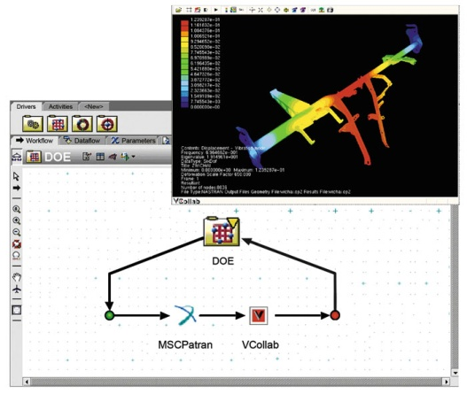
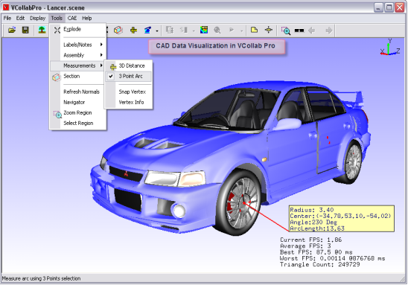
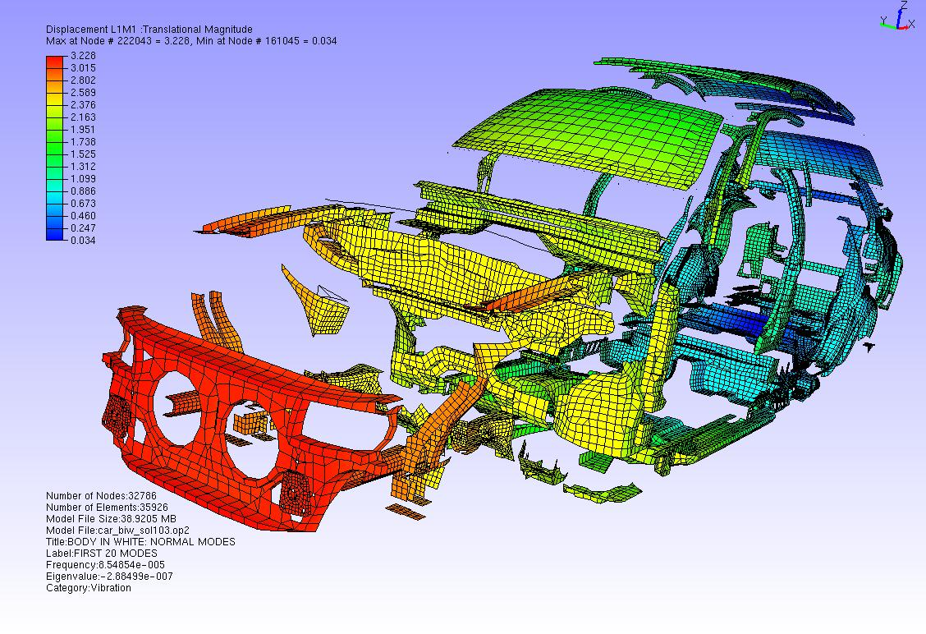
Our Solution
CAX - A vendor neutral, common data format to store and visualize 3D FEA/CFD data with extension to CAD – in an ultra compact form. Stores meta data.
Data retrieval and data reduction technologies
High performance Viewers
Integration with process and data management systems and job submission systems Ex. PLM /SLM /MDO etc
Notes:
9
Then, we have developed other essential tools around CAX. First are the tools for CAE data reduction. We overcame the most challenging part of the interface technology to 3rd party codes. We discuss more about them as we go.
Viewers were developed to view the CAX files, with state of the art graphics and high performance, from a simple Viewer to full VR environment. We will see the demo of these viewers at the end.
CAX files can be easily integrated with existing process and data management systems in an enterprise.

Slide 10
VCollab Solution
CAE
Durability
ABAQUS/
MARC
Thermal
ANSYS
NVH
Nastran/
NX
…
Impact
Ls-Dyna
CFD
StarCCM+
Fluent
…
VMoveCAE/ VMoveCAD / CAX Writer API
*.CAX
VCollab Presenter
Lite
VCollab
Presenter
VCollab
Professional
Notes:
10

Slide 11
VCollab supported CAE Applications & Formats
Natively Supported CAE Software | Formats Supported | Remarks
ABAQUS | ODB, FIL, INP | Supports V6.11
MSC.NASTRAN, NX.NASTRAN | OP2, BDF | Supports Complex Eigen Vectors
MSC.MARC | T16 and t17 plot files
ANSYS | RST, RTH, RFL | Supports ANSYS 12.0
LS-DYNA | D3PLOT files, key Files
ESI PAM CRASH | DSY files
FLUENT | Binary Output (.CAS and .DAT files)
ENSIGHT GOLD | .CASE, .ENCASE
PATRAN | .PAT, .OUT files
Star-CD (Star-CCM) | .CCM
FE SAFE | .fer
Notes:
Here are the CAE applications and the formats, that are currently supported by VCollab.
We continue to support more and more tools every year.

Slide 12
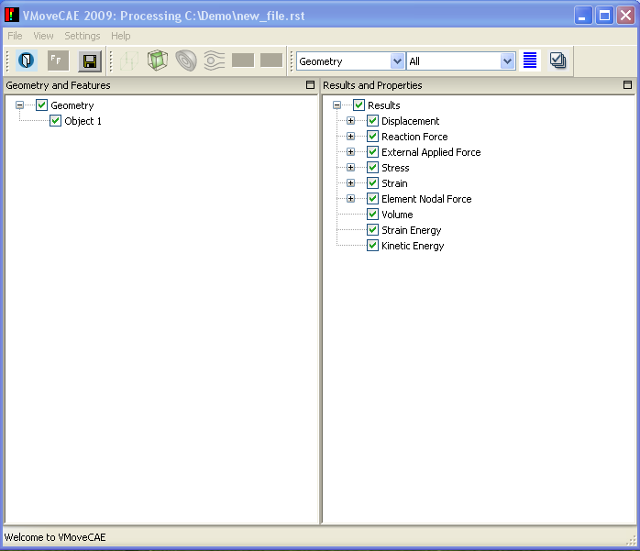
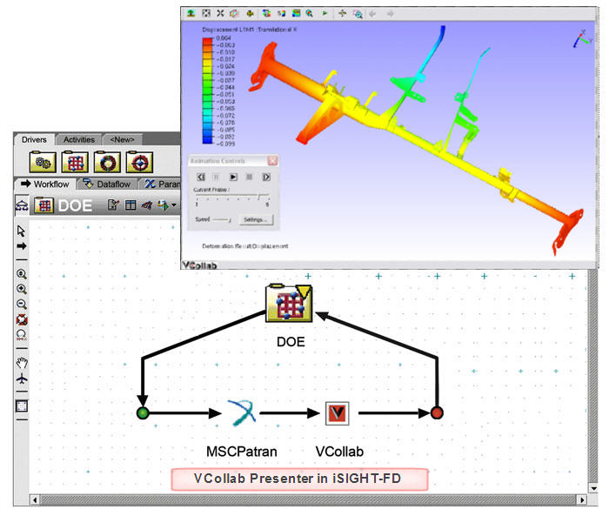
VMoveCAE : Universal Data Reduction Engine
VMoveCAE: Tool to reduce CAE data and generate CAX files and meta data
GUI
Batch command
Remote execution on HPC.
Supports Windows, LINUX etc.
Attributes based filters
Filter results
Filter Load Cases
Filter parts
Volume feature extractions
XML files for customizing reduction criteria
GUI mode
Batch Mode
Notes:
VMoveCAE is a key tool that works like a universal CAE data reduction engine. It reads native CAE data and converts the CAE models and results into compact CAX files.
VMoveCAE can be run interactively or in batch mode.
The batch capability allows enterprises to reduce the CAE results files on HPC/storage server into smaller CAX files as part of a job run. Then, the CAX files can be made available to global teams, suppliers for CAE visualization and collaboration.
Results, time steps/load cases, parts etc. can be filtered to only include the result types of interest. VMoveCAE uses XML templates for customizing the reduction criteria so that one can maximally compress the data. Departments or enterprises can capture their best practices, define them in XML files, and apply them to create CAX files that contain all of the model and results data of interest.

Slide 13
VMoveCAD supported native CAD applications
S. No. | CAD Package | Supported Versions | Supported Extensions
1 | Catia V4 | 4.15 to 4.24 | *.model
2 | Catia V5 | R7 to R20 | *.CATPart, *.CATProduct
3 | Unigraphics | v10 to NX7.5 | *.prt
4 | Pro/E | 2000 to WildFire5 | *.prt , *.asm , *.prt.* ,*.asm.*
5 | SolidWorks | 1999 to 2011 | *.sldprt *.sldasm
6 | SolidEdge | Upto ST3 | *.par *.asm *.psm
7 | Inventor | 10 to 2011 | *.iam , *.ipt
8 | IGES | Upto 5.2 | *.igs
9 | STEP | from AP203/AP214 | *.stp; *.step
10 | CGR | R10 to R20 | *.cgr
Supported Platforms : WIN 32 BIT, WIN 64 BIT

Slide 14
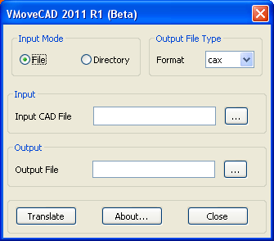
VMoveCAD GUI
Specify the native CAD file
Specify the target CAX file
Supported Platforms
Win 32 and WIN 64 BIT
Runs in Batch mode

Slide 15
PLM/SDM/SLM Components
SDM Functionality | VCollab Tool | Remarks
Meta Data Creation | VMoveCAE / CAEInfo | Eliminates Scripting
Creating light weight CAX files to provide common viewing of 3D simulations to all SDM users | VMoveCAE / VCollab Presenter | Reduces load on CAE Infrastructure
Automate the CAE Report generation | VCollab Pro /ImageGenerator Or VMoveAPI | Eliminates Scripting Enriched 3D Reporting/ Long term archival
Mark up management

Slide 16
Inter exchange with other formats
Dassault Systeme’s CGR and CAX ( CAD data can be exchanged between CGR and CAX ) – AVAILABLE
Siemens JT and CAX ( CAD data and basic CAE data can be exchanged between JT and CAX )
VMoveSTEP209 ( STEP209 to CAX ) - In Progress ( Available by 2nd Quarter of 2012 )
Inter operability between 3D XML and CAX – Planned for 3rd Quarter of 2012

Slide 17
VCollab Product Configuration
Product | Description | License Model
VMoveCAE | CAE Data Translator Works in Batch Mode as well as GUI Mode. Generates light weight CAX files from CAE results files. | - FlexLM - Floating- LAN - Floating- WAN
VCollab Presenter | Light Weight CAE viewer To view VCollab CAX files. Extends visualization to decision support. Works within MS Office, MS SharePoint and Web Browser integration. | - FlexLM - Node Lock - Named User
VCollab Professional | Thick Client / DMU type tool for CAX Multiple model overlays, Parts and Results filtering, Annotations, Viewpoints, Walkthrus, AVI/GIF Animations, Stereo Views can be created. | -FlexLM -Floating-LAN -Floating-WAN
VCollab Presenter Lite | Light Weight CAE viewer (w/ Limited Functionality) | Free
VMoveAPI | Provides ability to write CAX files from 3rd party CAE solvers, Post Processors, in-house CAE applications. | TBD
Notes:
VCOllab Presenter Lite ( free Viewer) and the CAX writer API are new products. Both are very significant for success of the CAE PDF startegy.
Presenter Lite allows enterprises to integrate designers, release engineers, service personal, partners and suppliers into the CAE data sharing and collaboration process.
CAX Writer API would allow the customers with in-house CAE software and the CAE vendors to write out the CAE results into ultra compact and portable CAX files.

Slide 18
VCollab New Products in 2011
Product | Description | License Model
VMoveCAD | CAD Data Translator Works in Batch Mode as well as GUI Mode. Generates light weight CAX files from CAD files. Also generates Meta Data files in XML format. | - FlexLM - Floating- LAN - Floating- WAN
JT2CAX and CAX2JT | JT inter operability Provide tools to interoperable with JT. | - FlexLM - Node Lock - Named User
Notes:
VCOllab Presenter Lite ( free Viewer) and the CAX writer API are new products. Both are very significant for success of the CAE PDF startegy.
Presenter Lite allows enterprises to integrate designers, release engineers, service personal, partners and suppliers into the CAE data sharing and collaboration process.
CAX Writer API would allow the customers with in-house CAE software and the CAE vendors to write out the CAE results into ultra compact and portable CAX files.

Slide 19
Share CAX
Thru e-mail
Thru PowerPoint or Word or Excel
Thru WEB Page
Thru SharePoint or other portals
Thru PLM
Thru SLM
Thru ERP

Slide 20
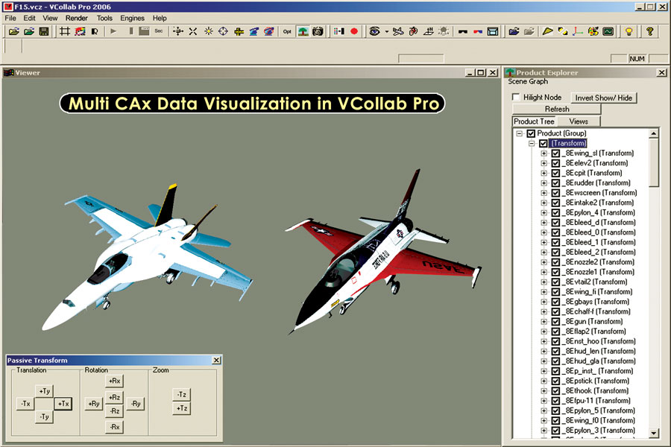
Multi CAx Data visualization

Slide 21
VCollab Product Configuration
Product | Description | License Model
VMoveCAE | CAE Data Translator Works in Batch Mode as well as GUI Mode. Generates light weight CAX files from CAE results files. | - FlexLM - Floating- LAN - Floating- WAN
VCollab Presenter | Light Weight CAE viewer To view VCollab CAX files. Extends visualization to decision support. Works within MS Office, MS SharePoint and Web Browser integration. | - FlexLM - Node Lock - Named User
VCollab Professional | Thick Client / DMU type tool for CAX Multiple model overlays, Parts and Results filtering, Annotations, Viewpoints, Walkthrus, AVI/GIF Animations, Stereo Views can be created. | -FlexLM -Floating-LAN -Floating-WAN
VCollab Presenter Lite | Light Weight CAE viewer (w/ Limited Functionality) | Free
VMoveAPI | Provides ability to write CAX files from 3rd party CAE solvers, Post Processors, in-house CAE applications. | TBD
Notes:
VCOllab Presenter Lite ( free Viewer) and the CAX writer API are new products. Both are very significant for success of the CAE PDF startegy.
Presenter Lite allows enterprises to integrate designers, release engineers, service personal, partners and suppliers into the CAE data sharing and collaboration process.
CAX Writer API would allow the customers with in-house CAE software and the CAE vendors to write out the CAE results into ultra compact and portable CAX files.

Slide 22
VCollab New Products in 2011
Product | Description | License Model
VMoveCAD | CAD Data Translator Works in Batch Mode as well as GUI Mode. Generates light weight CAX files from CAD files. Also generates Meta Data files in XML format. | - FlexLM - Floating- LAN - Floating- WAN
JT2CAX and CAX2JT | JT inter operability Provide tools to interoperable with JT. | - FlexLM - Node Lock - Named User
Notes:
VCOllab Presenter Lite ( free Viewer) and the CAX writer API are new products. Both are very significant for success of the CAE PDF startegy.
Presenter Lite allows enterprises to integrate designers, release engineers, service personal, partners and suppliers into the CAE data sharing and collaboration process.
CAX Writer API would allow the customers with in-house CAE software and the CAE vendors to write out the CAE results into ultra compact and portable CAX files.

Slide 23
Automatic CAE Report Generation
As is process
New process
ABAQUS
ABAQUS
HyperView /
ABAQUS CAE Viewer
VCollab
CAE Report
Find hot spots & Annotate
Find hot spots manually
CAX
Write them on a paper
Go to PowerPoint
VCollab saves 70% of analysts time in making reports
Annotate in PowerPoint

Slide 24
VCollab integration with MS Office, WEB, Enterprise Data Management and Process Management Systems

Slide 25
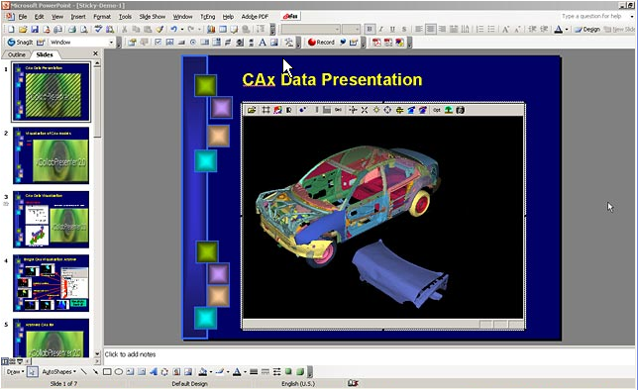
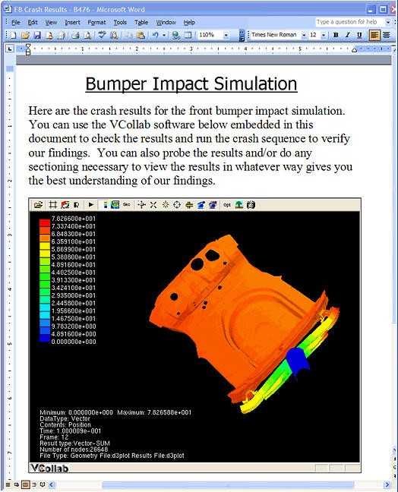
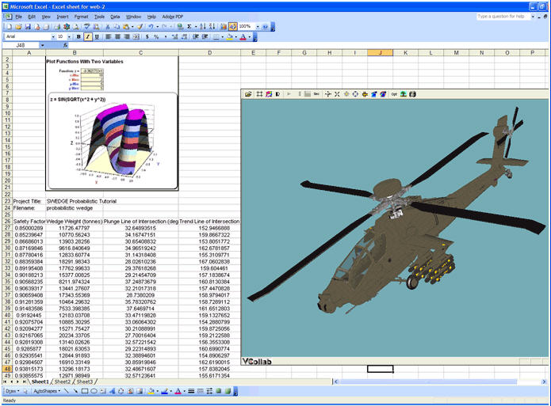
Interactive 3D Presentation / Documentation
with MS-Office
3D PPT
3D DOC
3D XLS
Notes:
I am sure, most of you heard about 3D PDF. With VCollab, you can make 3D PPT, 3D DOC, 3D XLS documents.

Slide 26
Integration with MS-Office & Web
(Report & Archiving)
CAD/CAM/CAE Tools
CATIA, UG, PRO/E, IDEAS, ABAQUS, NASTRAN, ANSYS, LS-DYNA, Fluent, EnSight, etc.
Passive
Interactive 3D
JPEG
MPEG/AVI
CAX
PowerPoint, Word, Excel, WEB Page
Interactive 3D Engineering Documents
Value : Ease of Use, Decision Support to SDM
Notes:
Let us talk little bit more on the CAX and MS office integration and see what it offers to CAE community.
As the diagram shows, 2 different worlds exist in our work environment. One is a very complex CAE domain where only experts can effectively use complex and expensive software tools. The other world is the easy-to-use MS Office world. Everyone knows how to use popular Office tools like Excel, Word, and PowerPoint. VCollab bridges these 2 worlds with CAX and VCollab Viewer. With this capability, CAE community can build interactive 3D Engineering Reports that everyone can use.
It is common practice in CAE community to create a number of images, videos and use them as lightweight vehicles for CAE communications.
CAE CAX files enhance these CAE communications with interactive 3D. CAX files have similar integrations with MS Office documents or WEB. One can take CAX file and embed into PowerPoint slide as easily as one embeds an image or video. We will show a demo of this in a bit.

Slide 27
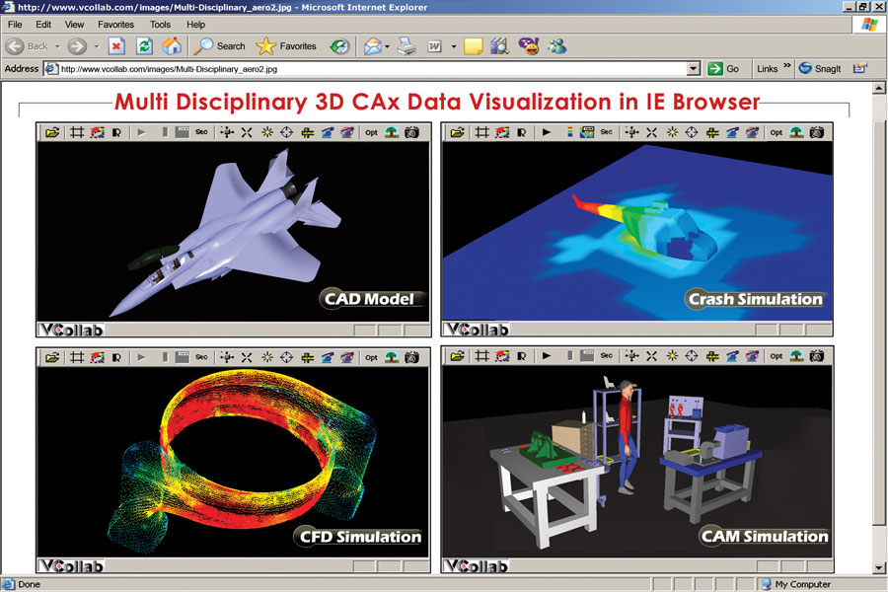
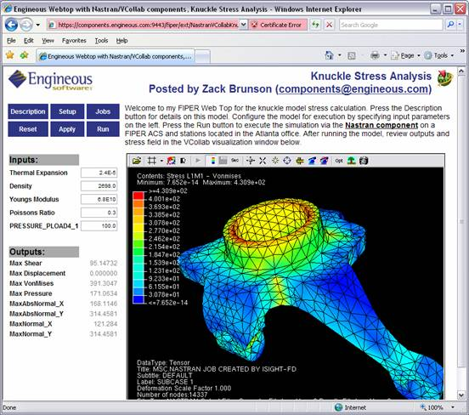
Integration with Web
Integration with
Simulation Process Management
Web Integration
Notes:
Similarly, CAX files can be integrated into WEB pages.
Significant point to note is that the CAX files and VCollab Viewer are integrated with many CAE process management systems as well as Simulation Data Management systems.

Slide 28
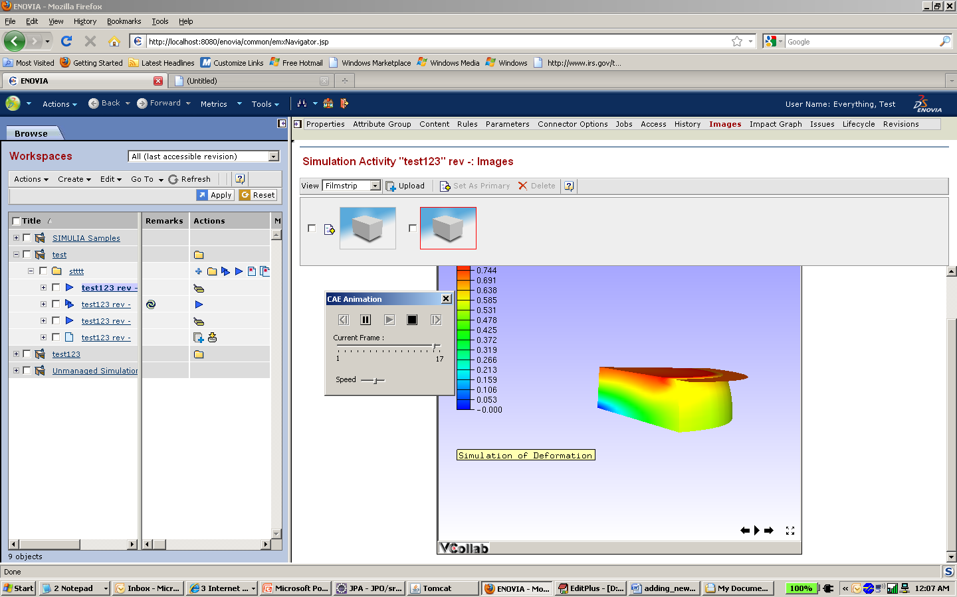
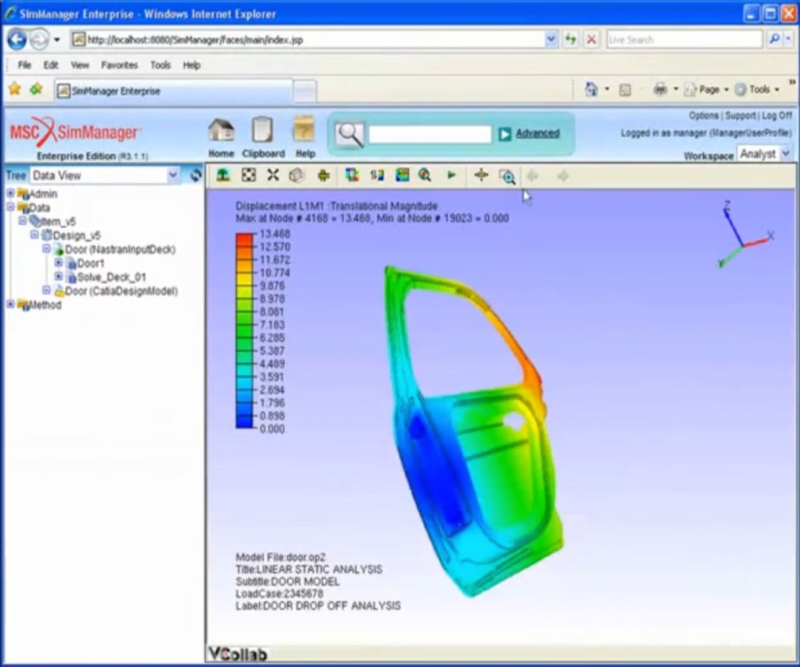
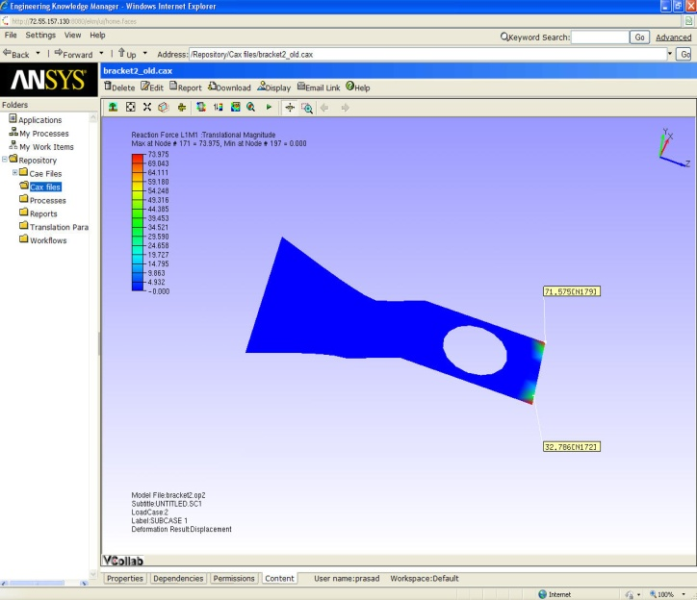
Integration with Data Management Systems
Simulia/SLM
MSC/SimManager
Phoenix Analysis Library
Ansys/EKM
MS SharePoint
Team Center Simulation

Slide 29
VCollab Components
Provide universal compact CAE format (.CAX)
Proprietary VCollab format
Typically 50-99% compressions rates
Provide CAE data reduction tools (VMOVE) to create CAX files
VMoveCAE - Supports most of the leading CAE software
CAXWriterAPI – for non-supported and in-house codes
VMoveCAD – Supports most of the leading CAD software
Provide a common, easy to use and scalable CAE Viewers (VCollab)
Provide integration with general tools ( WEB, MS Office, PLM, SLM etc.. )
Provide automated report generation
FEA
NASTRAN
MSC MARC
ANSYS
ABAQUS
LS DYNA
SDRC
FESAFE
PAM CRASH
CFD
FLUENT
STARCCM
…
PRE/POST
EnSight
Mesh + Transient Data
CAX .. Common Light Weight Data Model/Format

Slide 30
Summary
CAE Data Reduction
Unified Visualization
Presentations and Analysis Reviews
Light Weight Data Sharing and Collaboration

Slide 31
OEM Details
Reseller
VMoveCAE
VCollab Presenter
VCollab Pro
VMoveCAD ( New *** )
OEM Products
CAX Writer API ( Available )
Presenter ( Will be available in 2nd Quarter 2012 )
Bundled Products (under Pera’s Product ) : Most popular currently ***
VMoveCAE
VCollab Presenter
VCollab Pro
VMoveCAD Ver 1.0 (New *** )

Slide 32
OEM Details

Slide 33
THANK You!!!
Check us out at
http://www.vcollab.com
http://www.marechi.com

